Slide 1
Why we document?
“Impossible is always temporary”
Sharing for change rather than delaying the change.

Slide 2
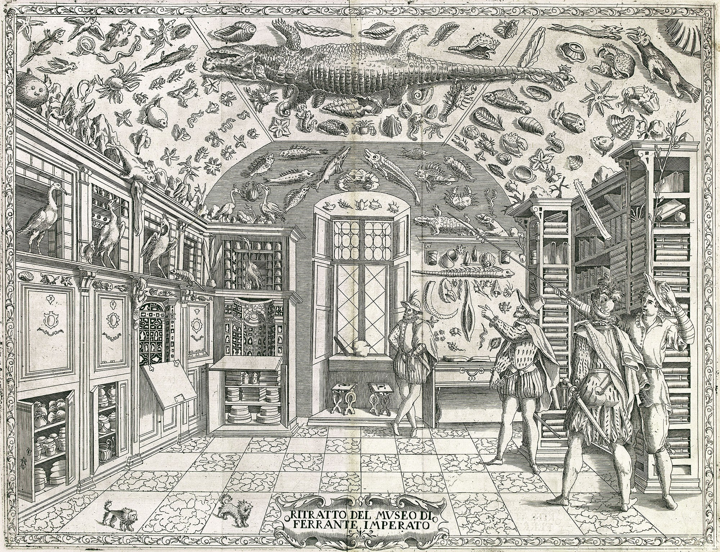

Slide 3
Ideas, process, outcomes
We are creatives!
Our process and the way we connect concepts is unique
Our process is made of choices, we choose one option and create a new path from there
All the other paths are there to be explored later on…when you document!
Outcomes of experiments are not always as we expected, documenting them…helps us to track information that we can use later on.

Slide 4

It’s all about process
Notes:
It’s all about process, nobody is interested in replicating exactly what you made.
But if everybody would credit, we will all get our piece of acknowledgement.
No work or process is your only, its the work of hundreads of years implemented in one concept.

Slide 5

To share your work, share your process.
Notes:
It’s all about process, nobody is interested in replicating exactly what you made.
But if everybody would credit, we will all be a step further by tomorrow morning.
No work or process is your only, its the work of hundreads of years implemented in one concept.

Slide 6
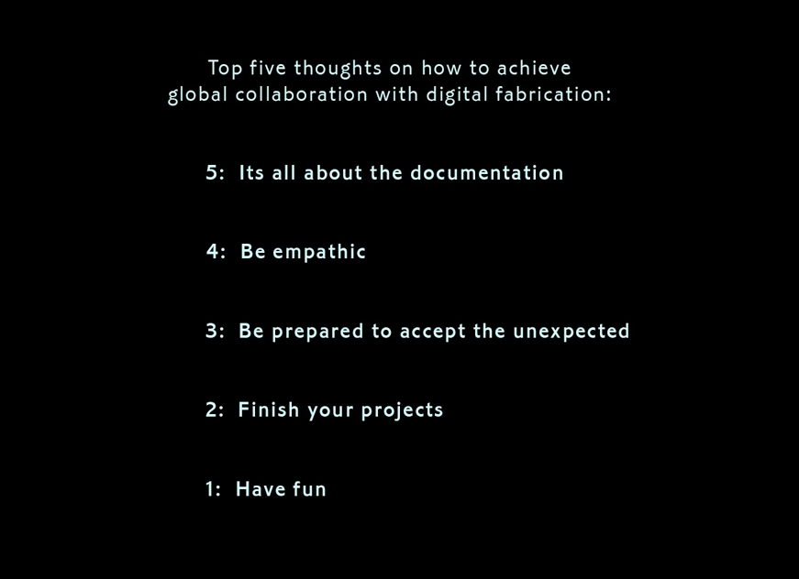
Jens Dyvik – from the movie: Making Living Sharing,

Slide 7
SHARE
PROCESS /
TECHNIQUE
“how to”
Will be applied to something else because the design is different
DESIGN
“what”
Will be made into something else because materials are different all over the world and you can customize your products

Slide 8

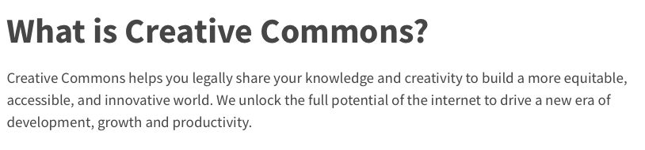
Notes:
So how do you creadit and share your work?
Most people that release content they produce, they do it by sharing it online.

Slide 9
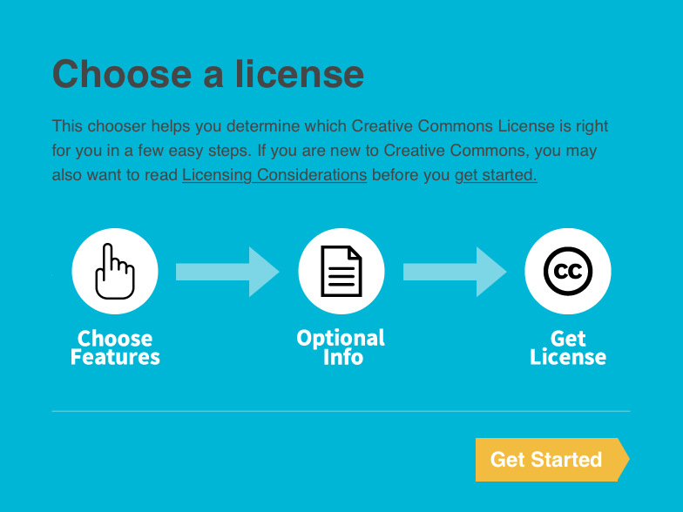

Slide 10
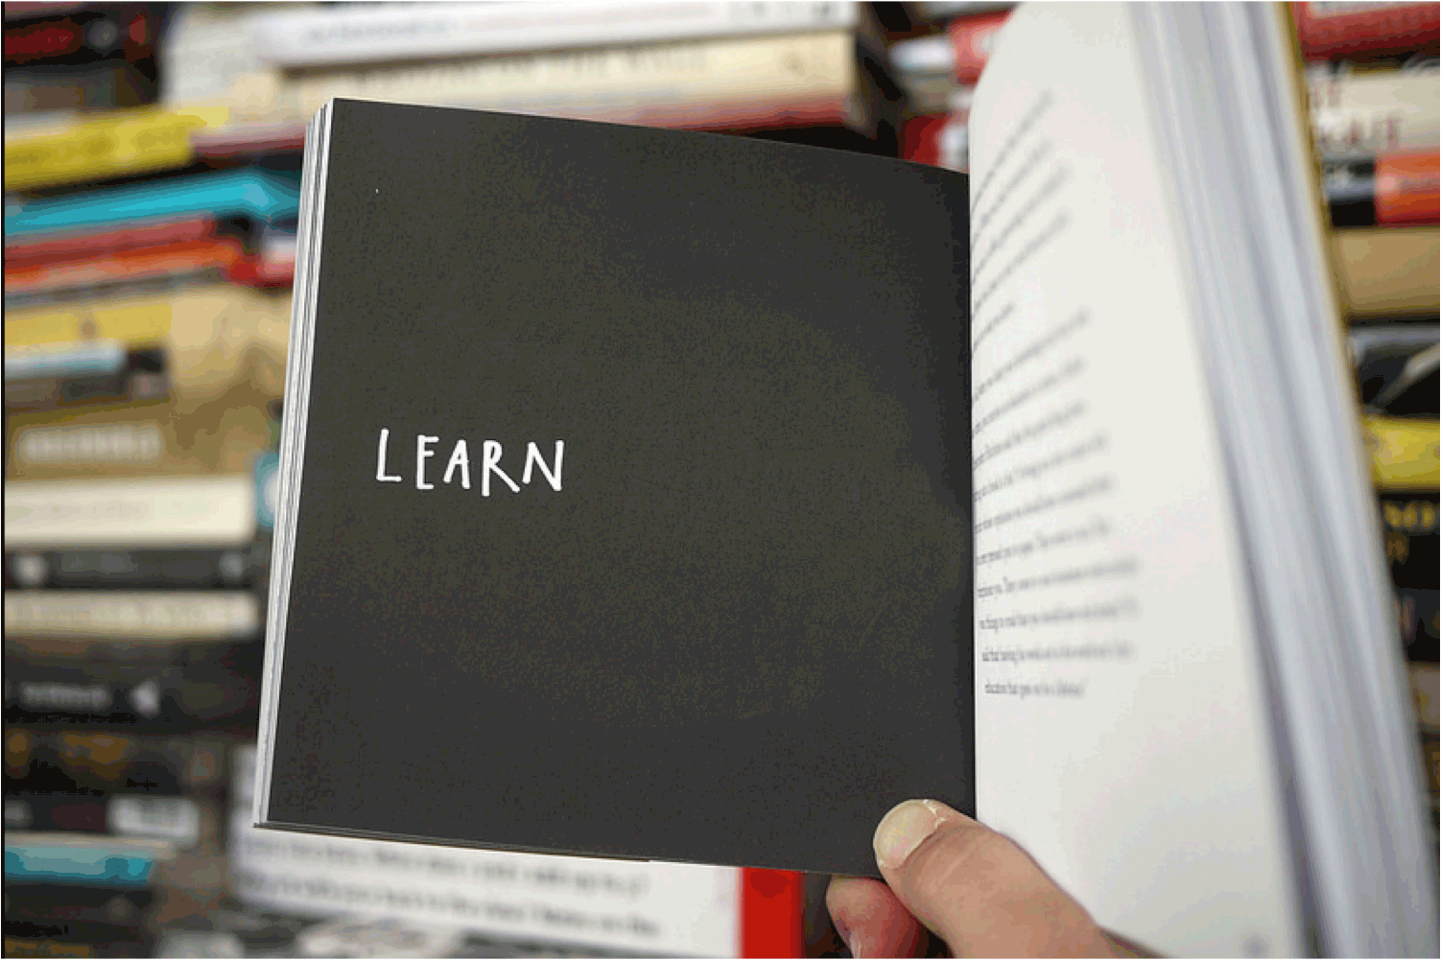
Austin Cleo– Share your work,

Slide 11

Global networks
– human networks –

