Slide 1
Soft Robotics Assignment

Slide 2
1.) BASIC - Pneumatic brace
2.) INTERMEDIATE – Pneumatic gripper
3.) ADVANCED – Controlled actuation, varied materials…
Notes:
Soft Robotics best suited to near skin applications and grippers – gentle and delicate

Slide 3
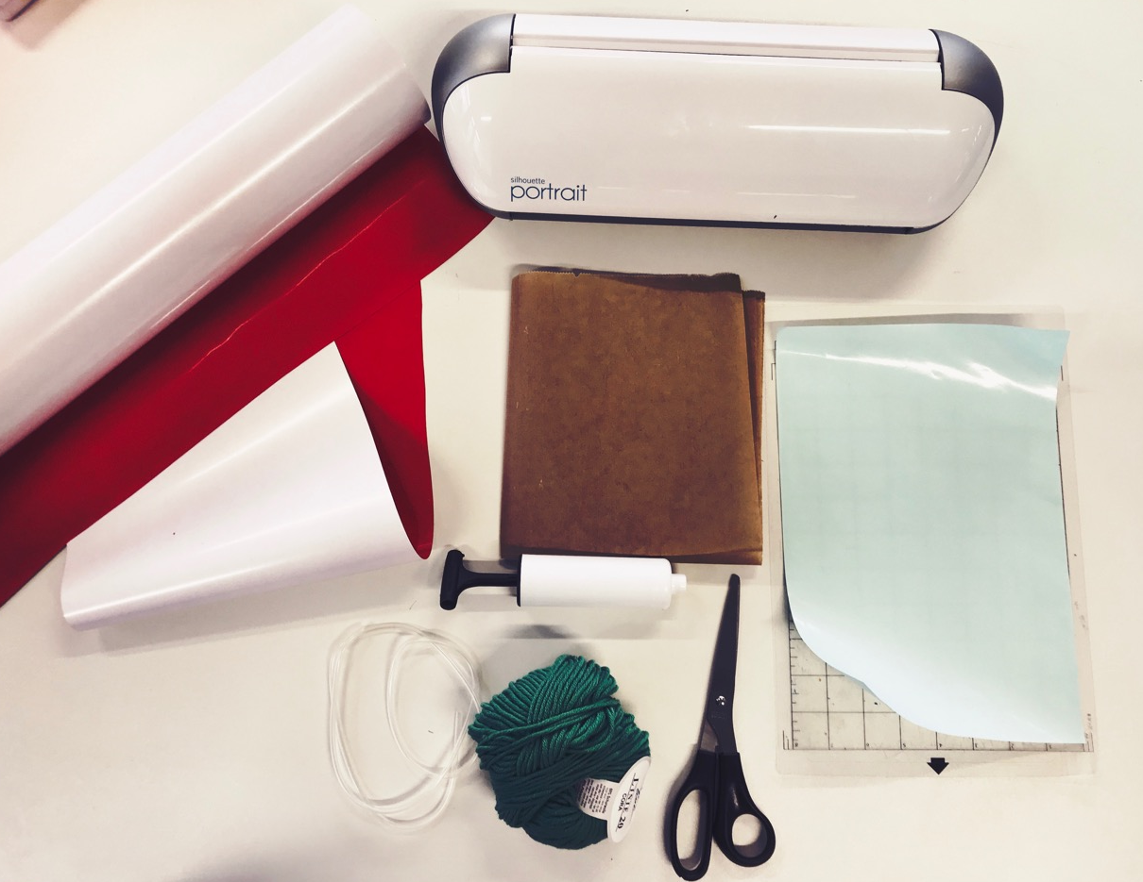
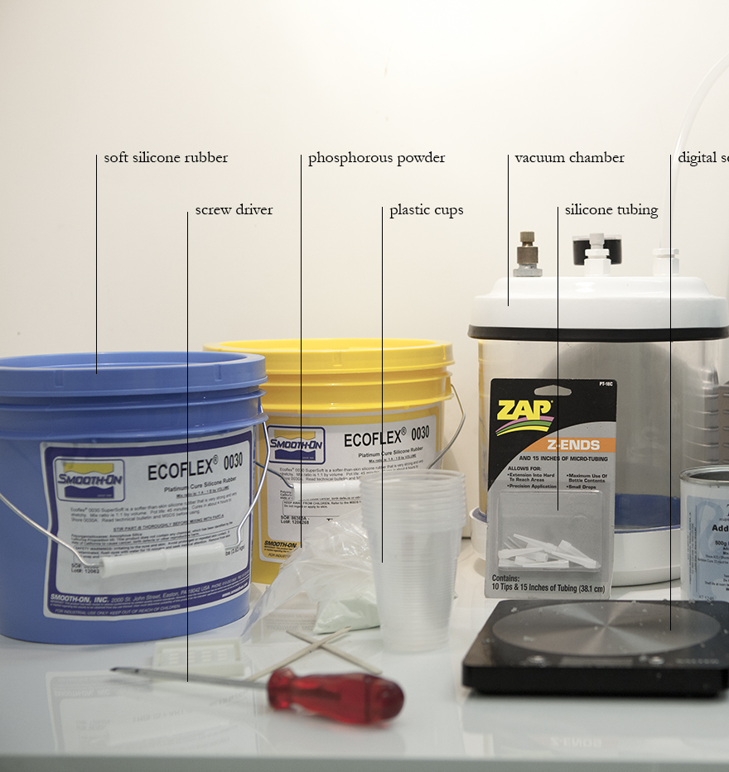
Materials

Slide 4
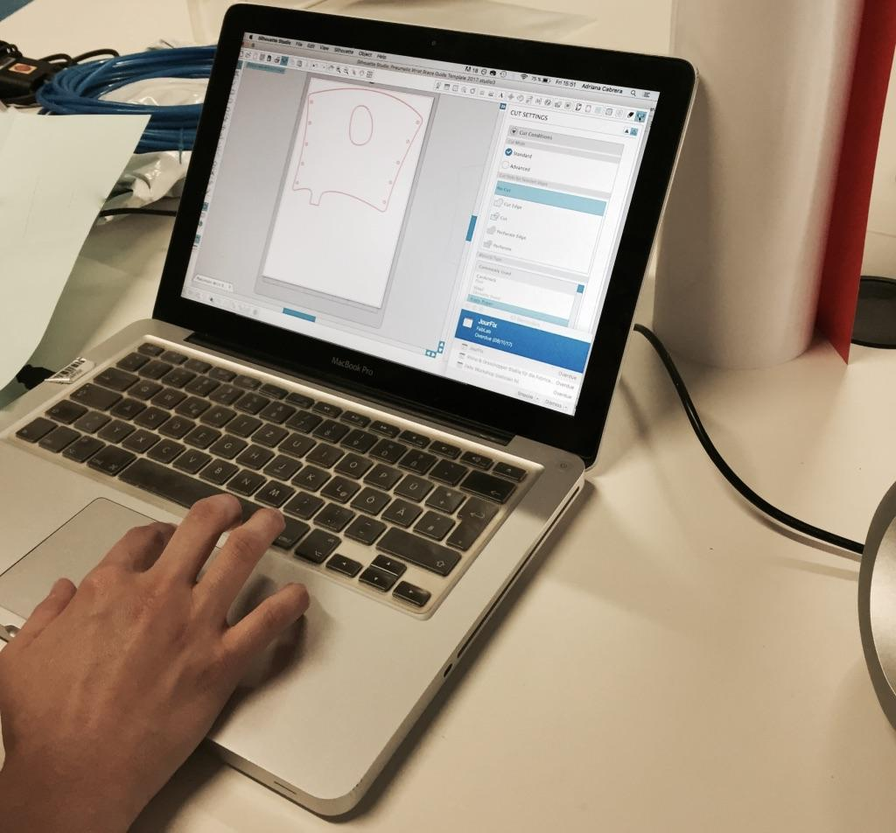
BASIC – Pneumatic brace

Slide 5
Cut and assemble

Slide 6
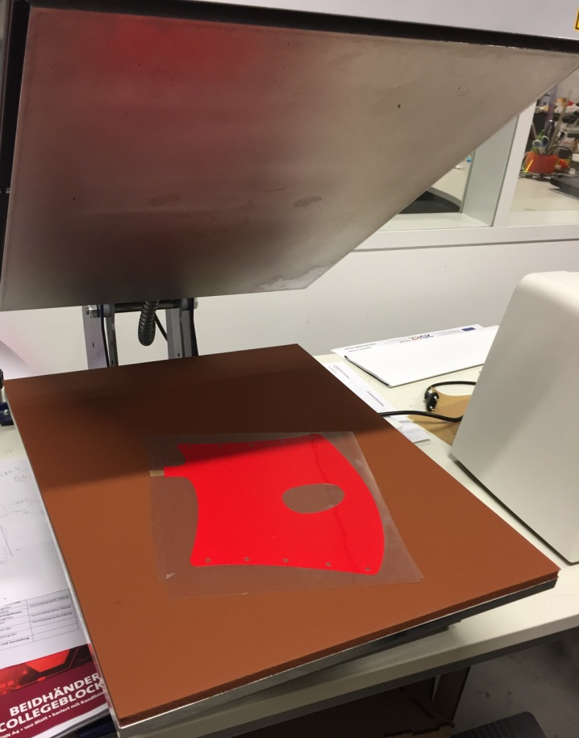
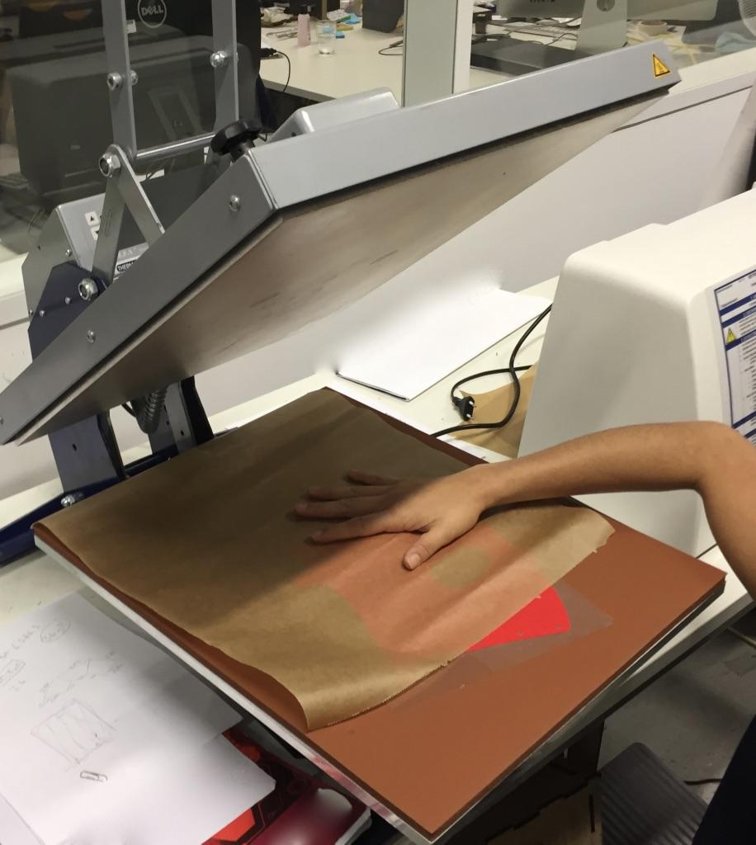
Sealing the materials - Heating
with Iron or thermotransfer press

Slide 7
Troubleshooting
close all the holes and be
you can cover the PP tube with PTFE heat shrink/

Slide 8
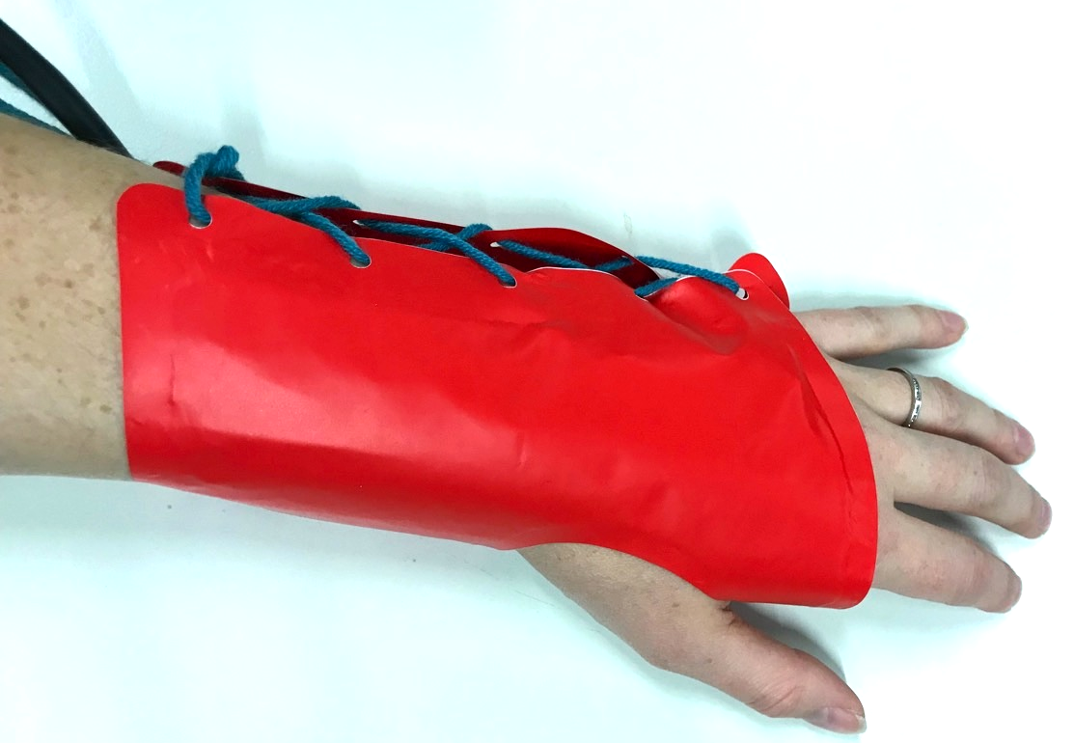

Slide 9
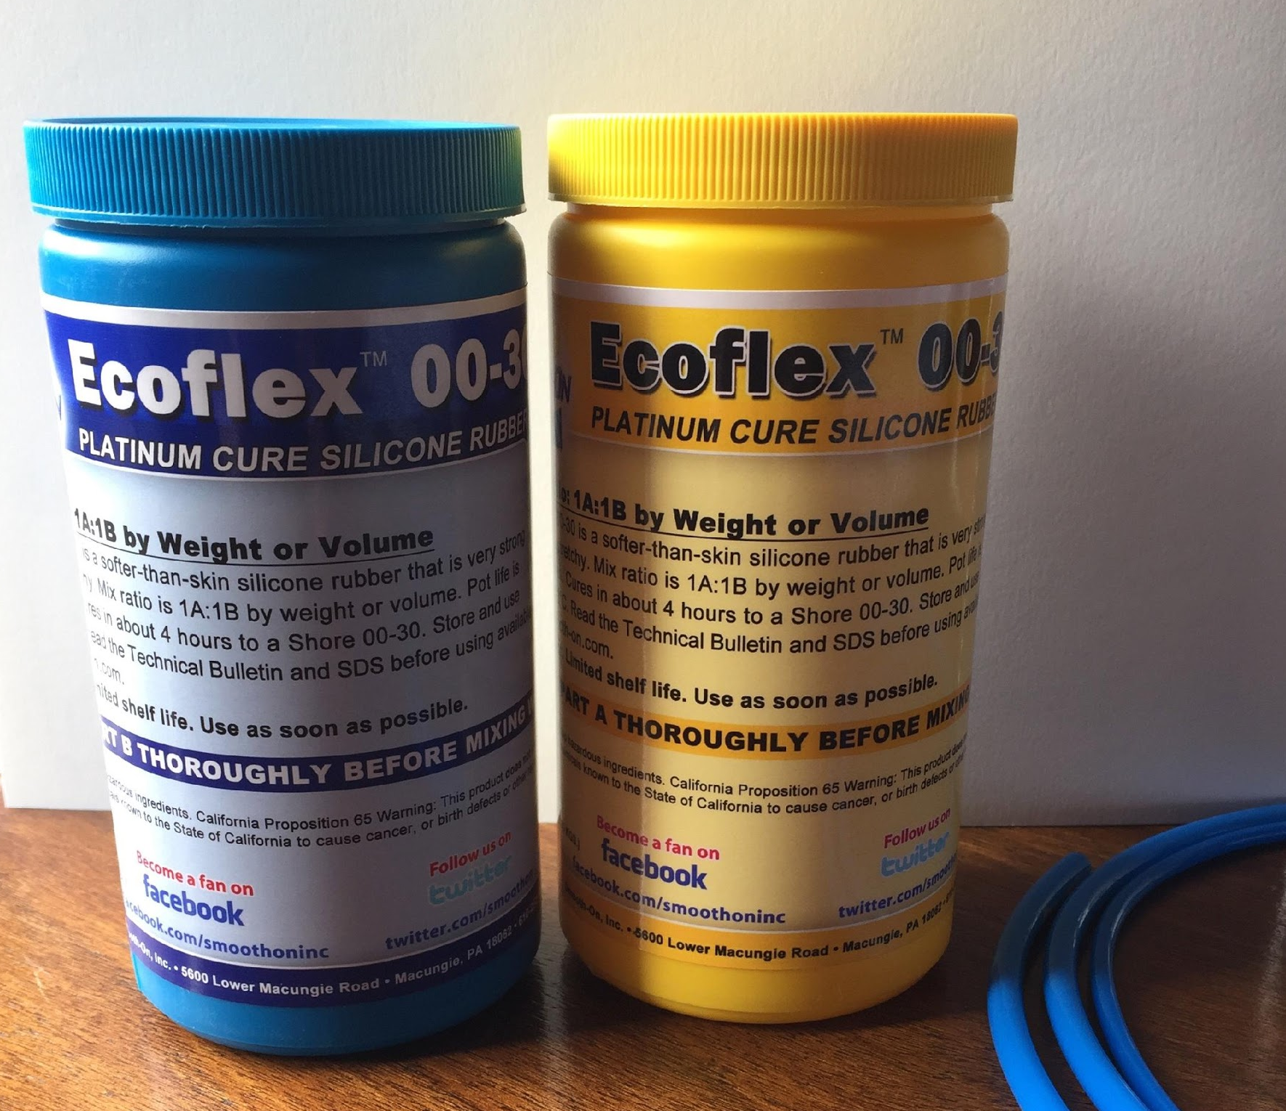
INTERMEDIATE - Gripper

Slide 10
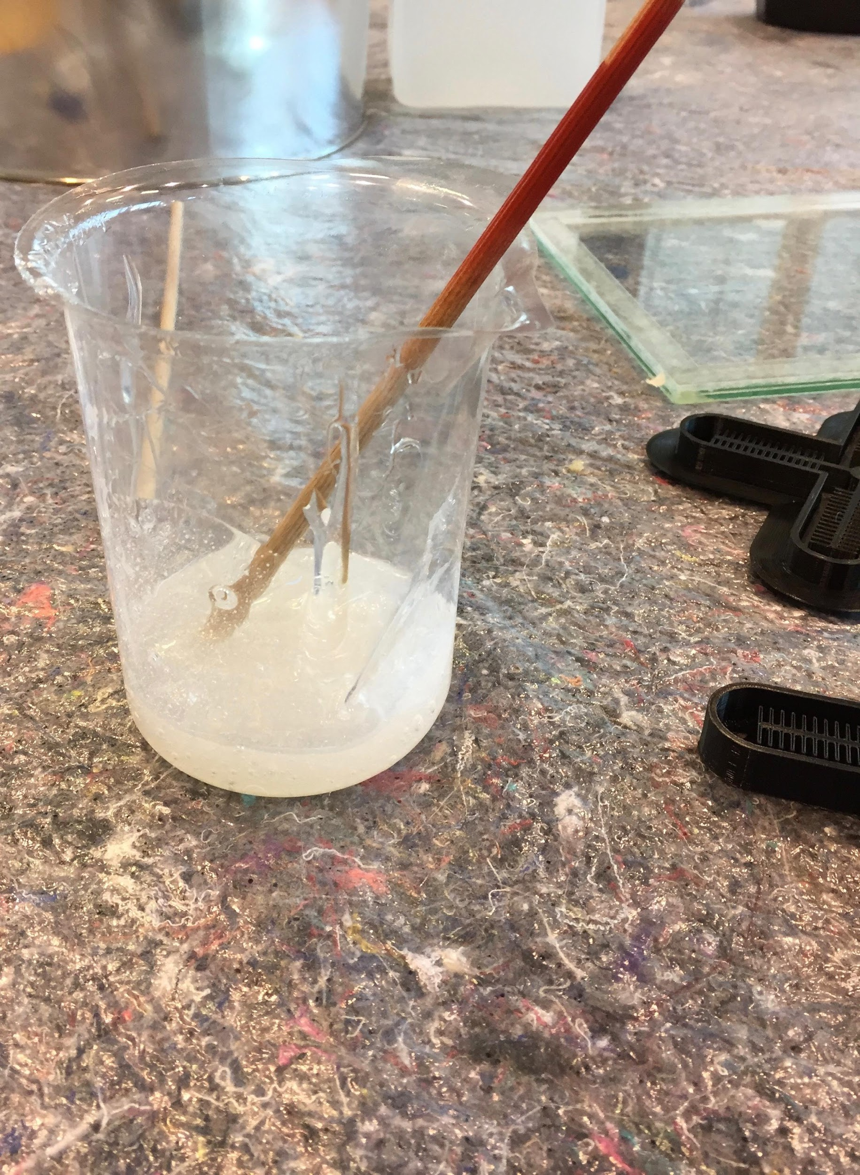
Mixing part A & B

Slide 11
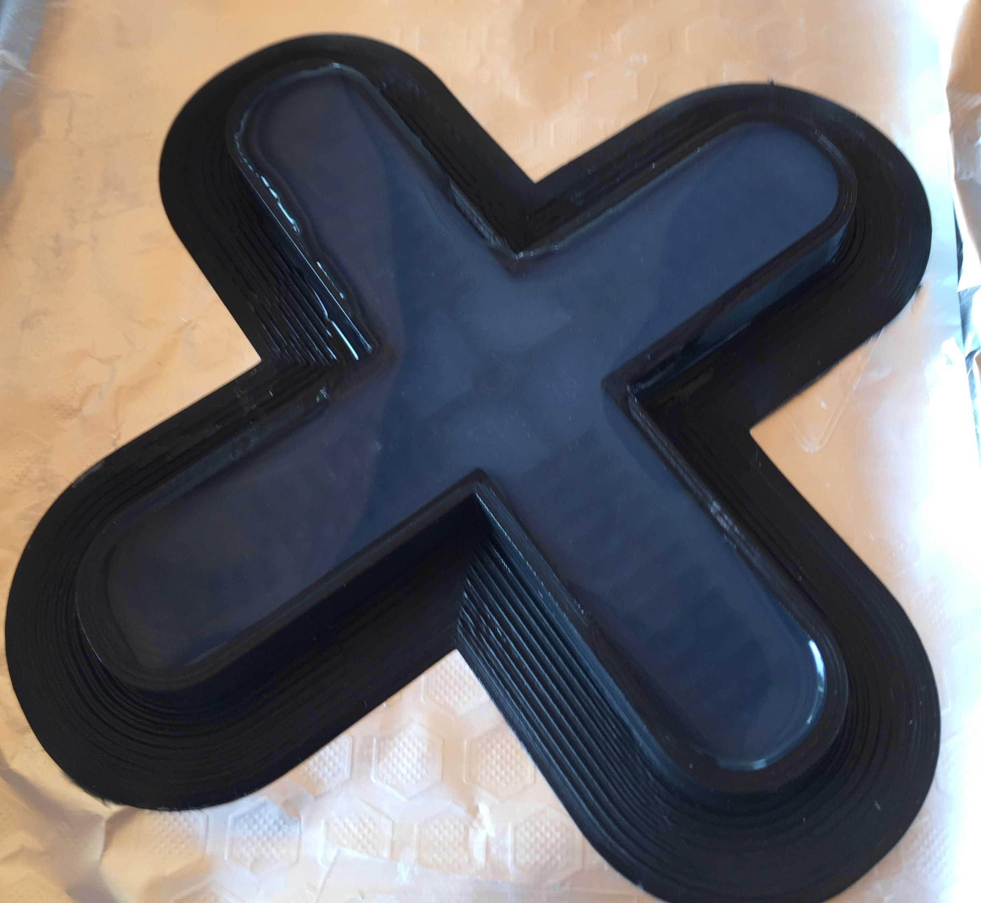
Filling the 3D printed mold and second layer

Slide 12
Ecoflex 00-30
NEUKASIL RTV145

Slide 13
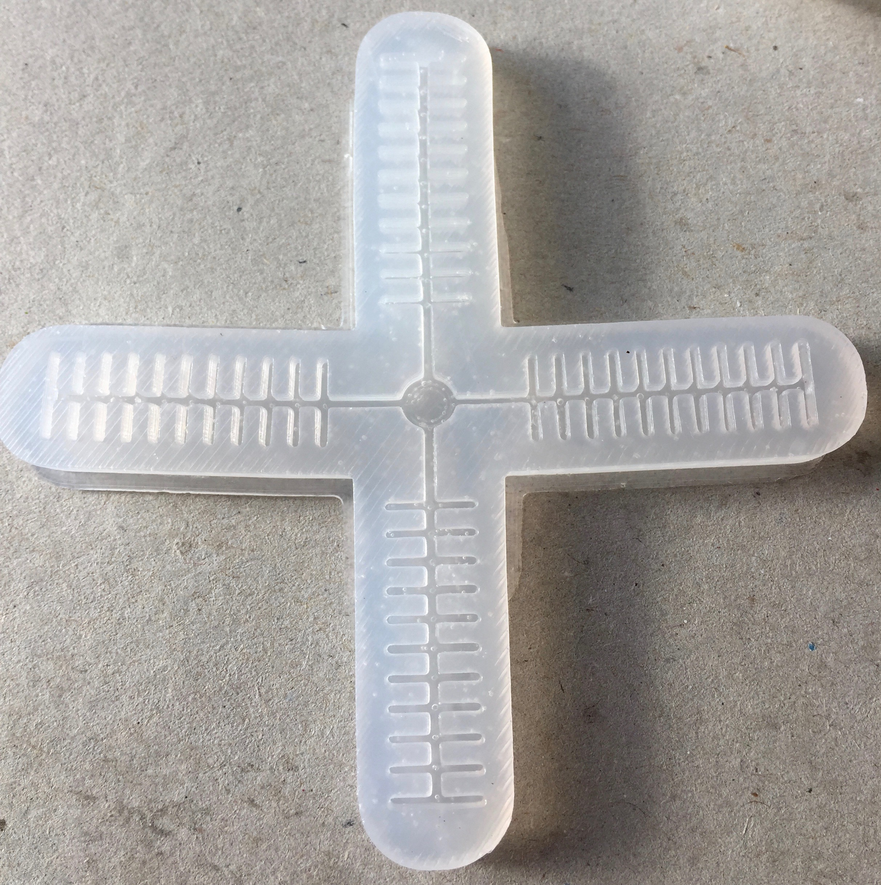
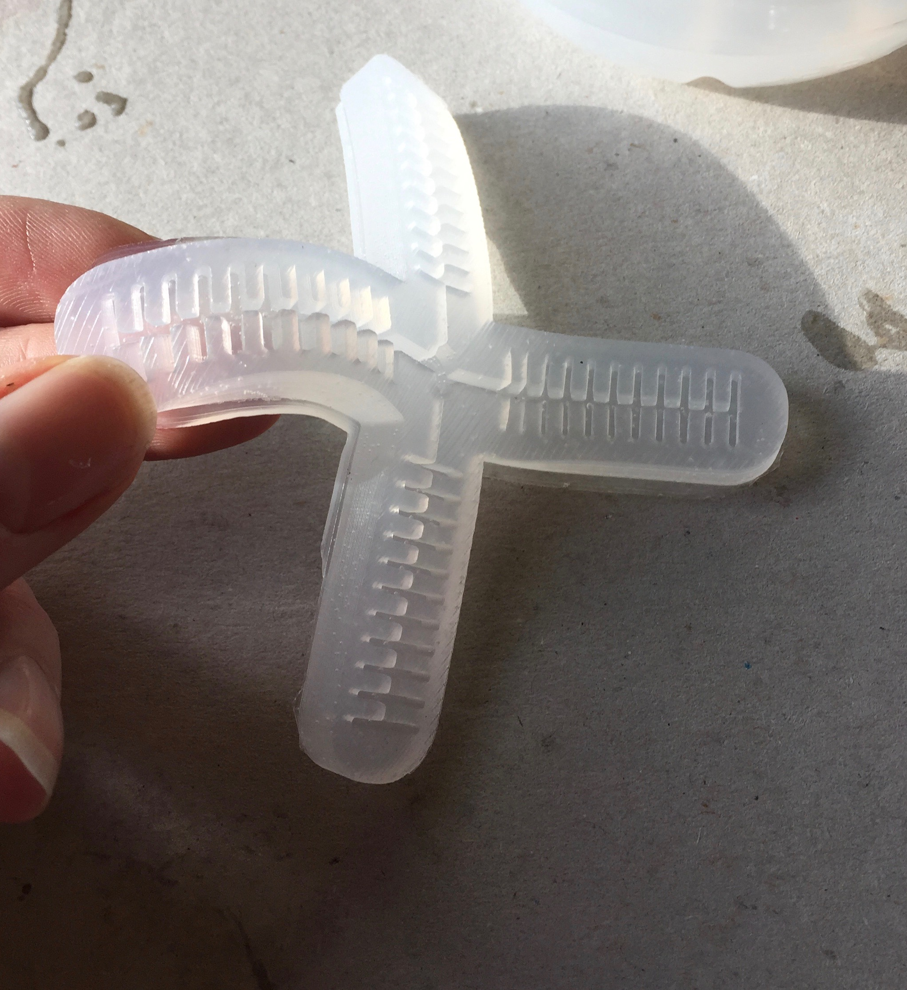

Slide 14
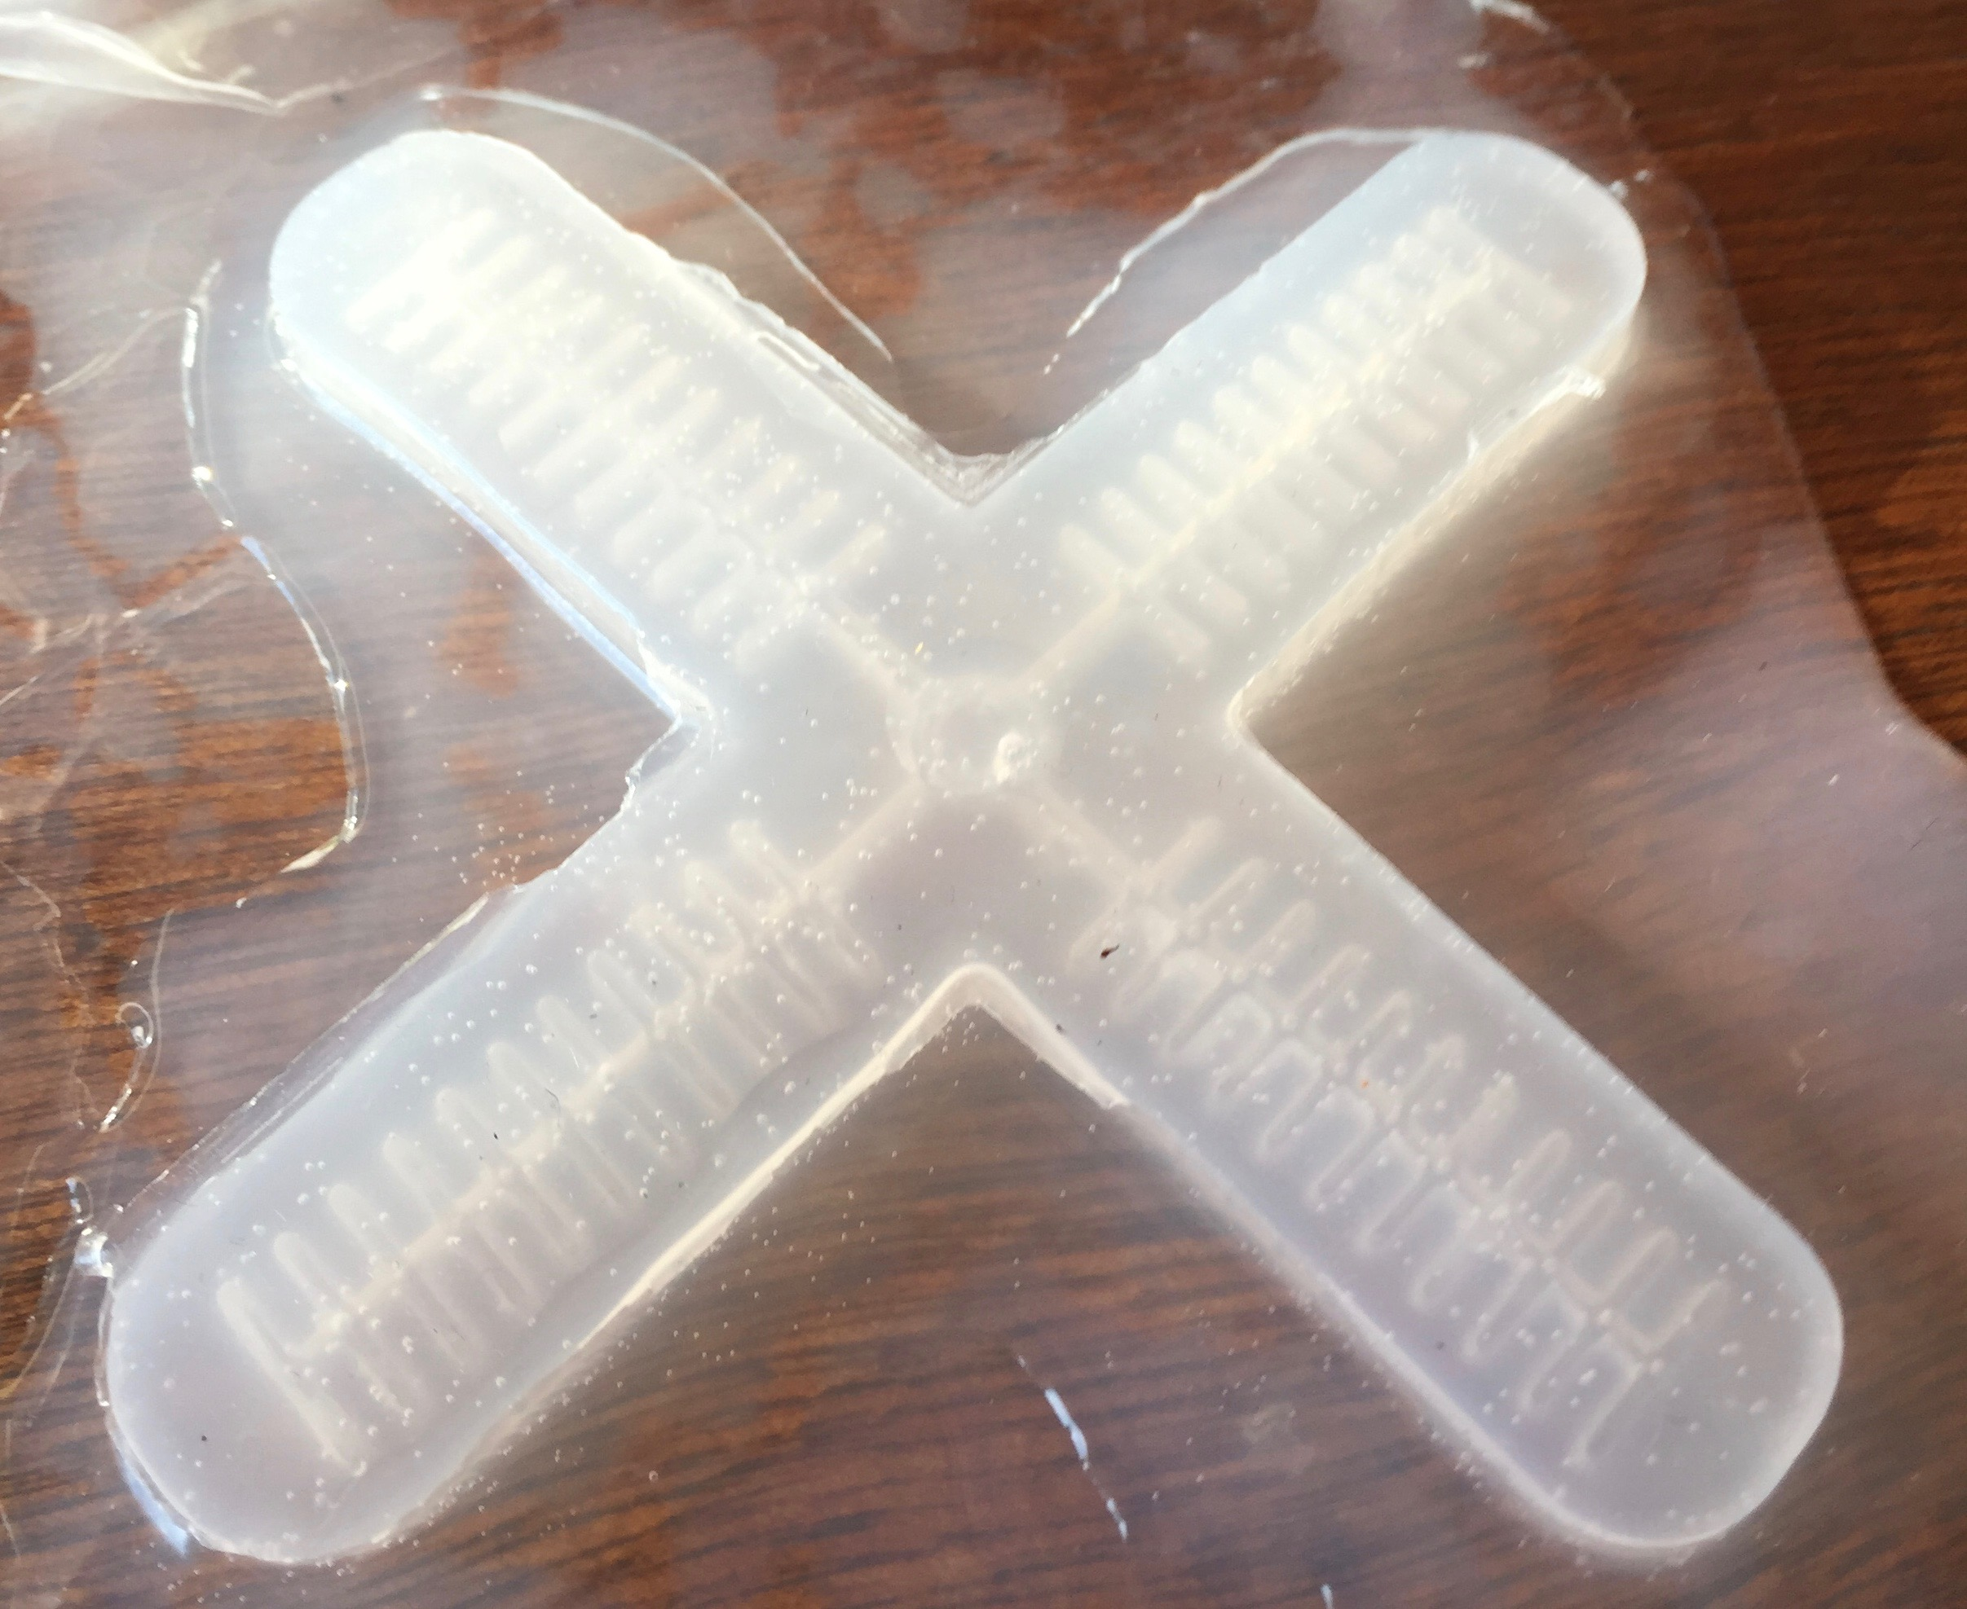

Slide 16
Troubleshooting…

Slide 17
Possible issues…

Slide 19
ADVANCED
Other control -
Other materials -
Other designs -

Slide 20
Controlling the actuation

Slide 21
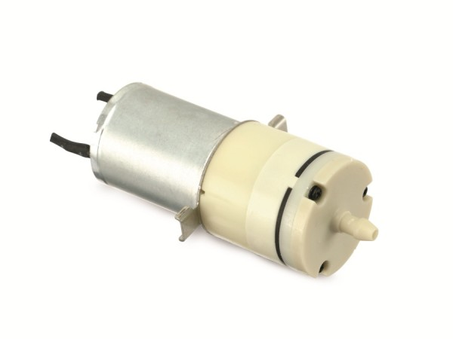
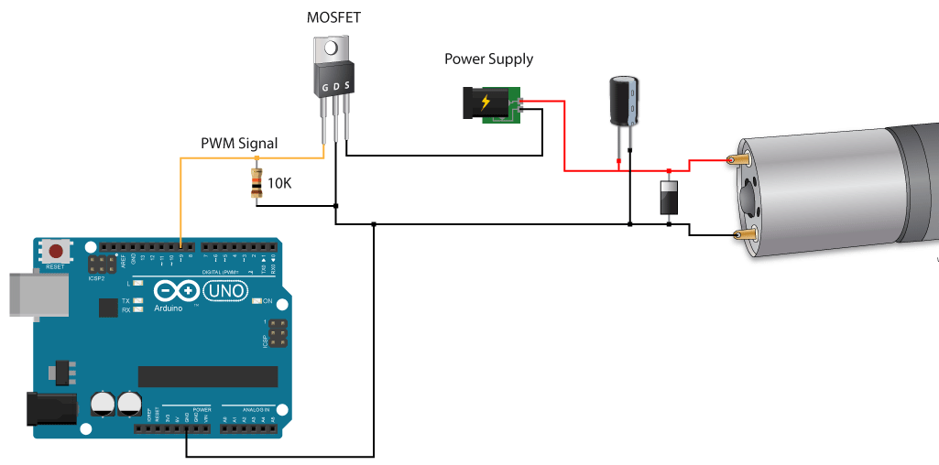
//softroboticstoolkit:Controlling the sensors with DC pump motors

Slide 22
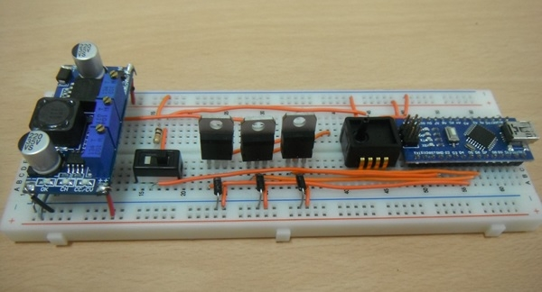
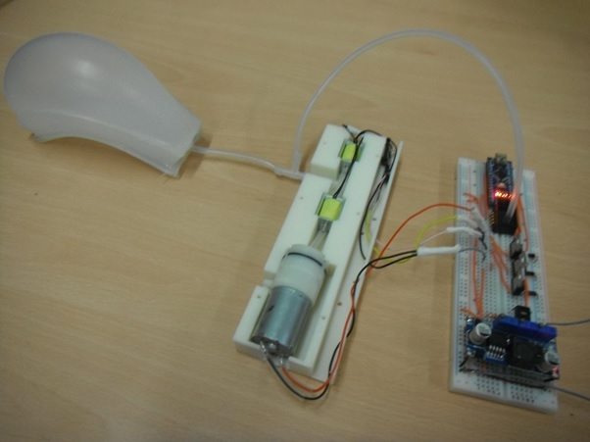
//softroboticstoolkit: Control soft robotics low-cost-ep-circuit
Notes:
https://softroboticstoolkit.com/low-cost-ep-circuit
https://softroboticstoolkit.com/soft-wheel-robot/fabrication/pcb-code

Slide 23
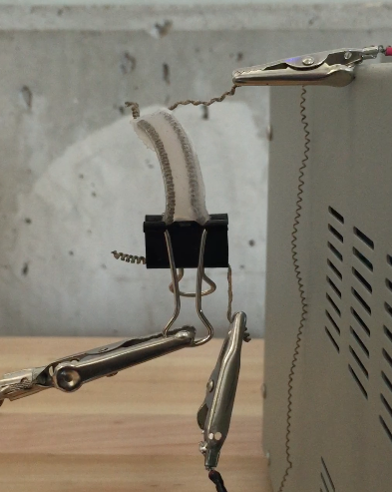
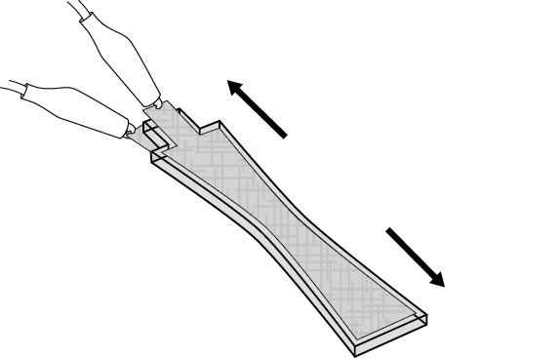
//softroboticstoolkit: Textile Silicone Hybrid Sensor
Notes:
https://softroboticstoolkit.com/book/miniature-soft-bending-actuator-embedded-coiled-muscles
http://www.mdpi.com/1424-8220/14/7/11957/htm

Slide 24
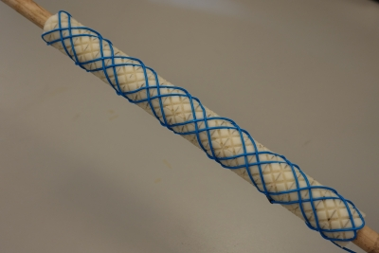
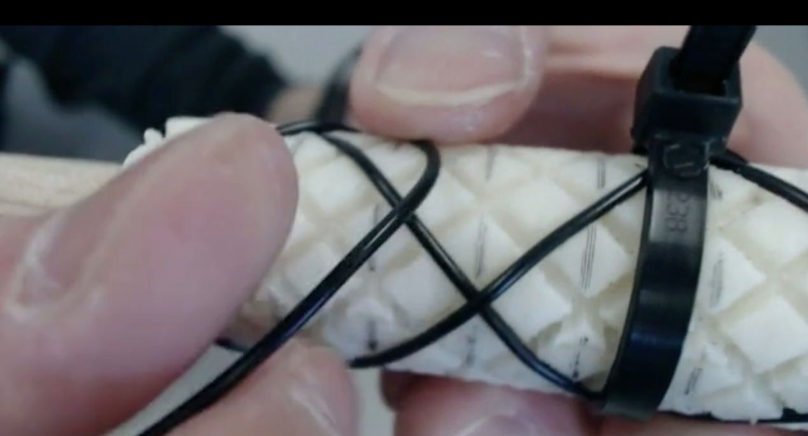
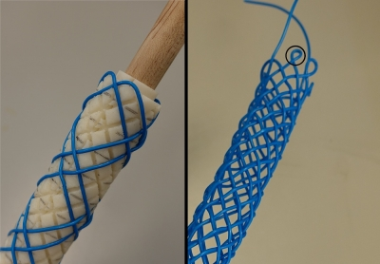
//softroboticstoolkit: Making your weaving pattern
Notes:
https://softroboticstoolkit.com/smart-braids
https://robotics.umich.edu/category/smart-braids/
https://softroboticstoolkit.com/smart-braids/fabrication/weaving
making your own weaving pattern

Slide 25
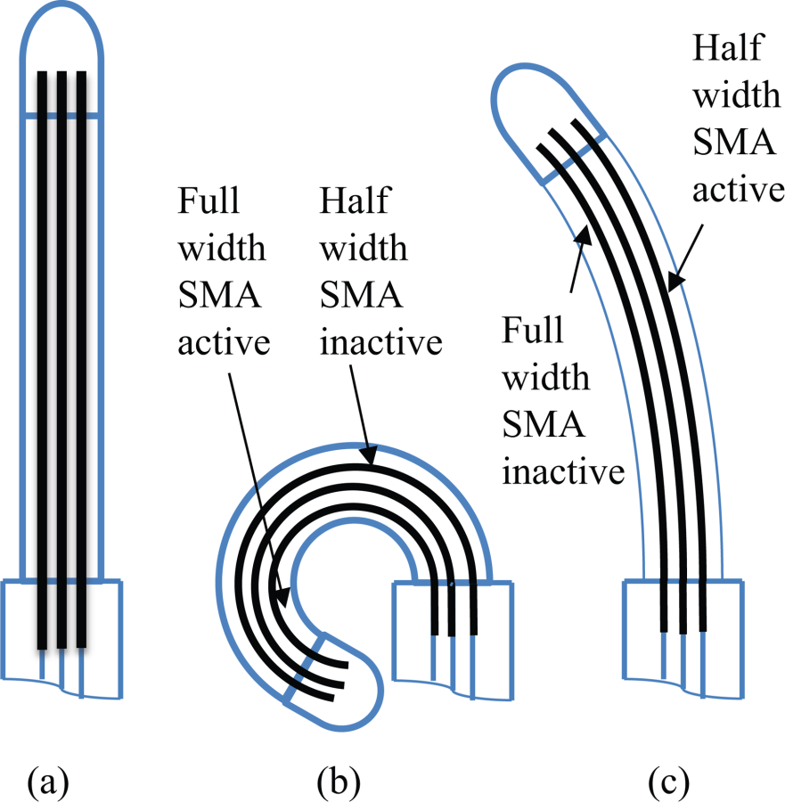
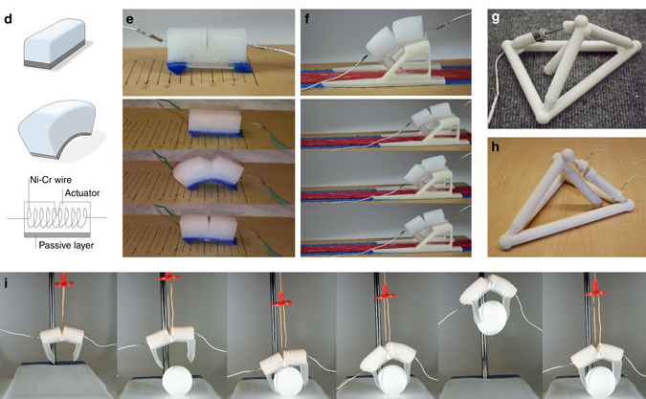
Smart Memory Alloys SMA
Use of the actuator in the interior and exterior part of the soft material
Notes:
http://mechanismsrobotics.asmedigitalcollection.asme.org/article.aspx?articleid=2089577

Slide 26
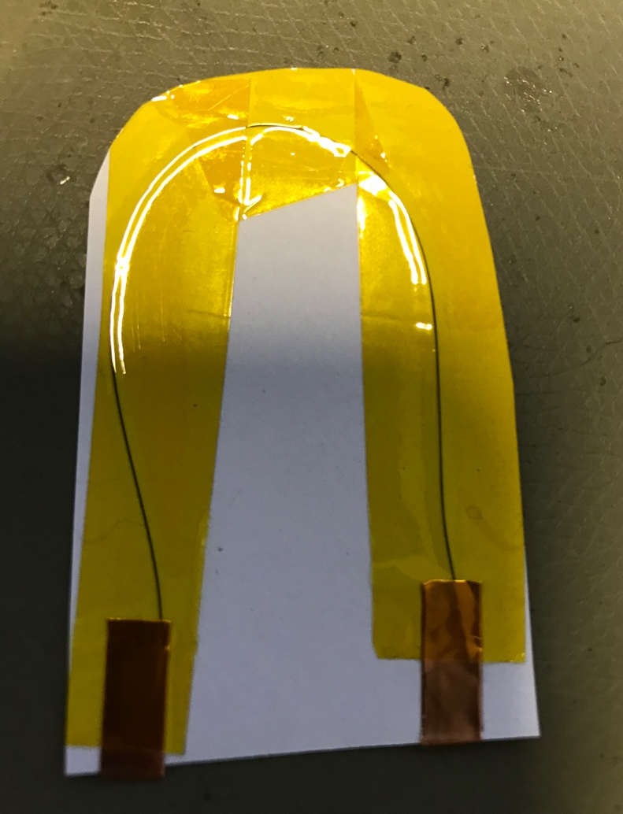
Issues
Notes:
test before the flexinol wire depending on the diameter of the wire and the length of the pies you mus to convert apply the proper V. and mA
you can test it in paper or a piece of textile
yuo can test to embed the wire in to on of the layes of your sof robotus , although the movment is very small
test to construct your own weaving pattern and enved the wire on it in order to generate mor movement in shape

Slide 27
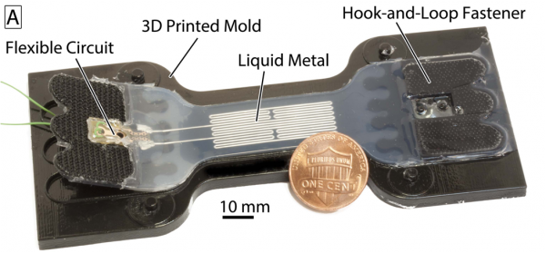
Using Flexible electrodes
Conductive Ink
Conductive carbon grease
Sputter coatings
Notes:
https://softroboticstoolkit.com/book/egain-design
https://www.bareconductive.com/shop/

Slide 28
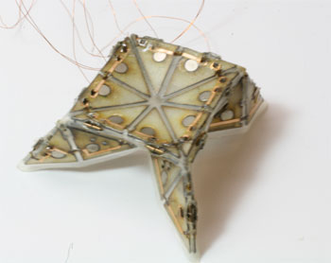
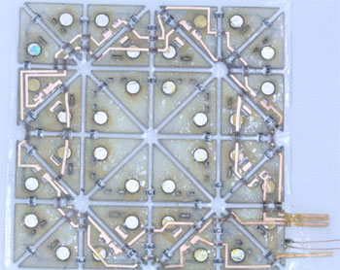
Soft material with conductive material
Notes:
http://sti.epfl.ch/page-76555-en.html
using conductive tape (for cutting the copper you can use the cutting plotter)
using conductive ink
bare conductive ink (carbon based): https://www.bareconductive.com/shop/
Agic ink: https (Silver based): //shop.agic.cc/
embedding nitinol SMA in small Areas.

Slide 29
Experimenting with other materials

Slide 30
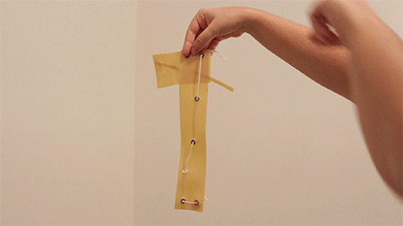
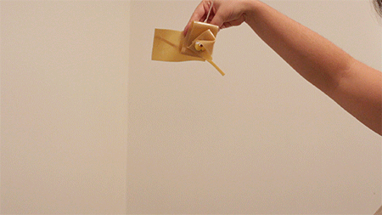
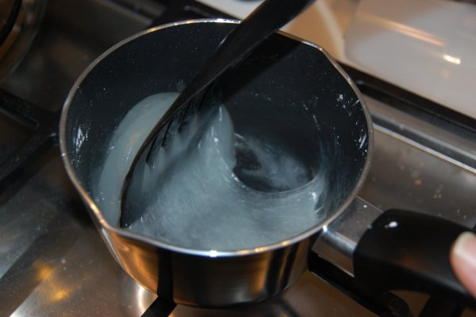
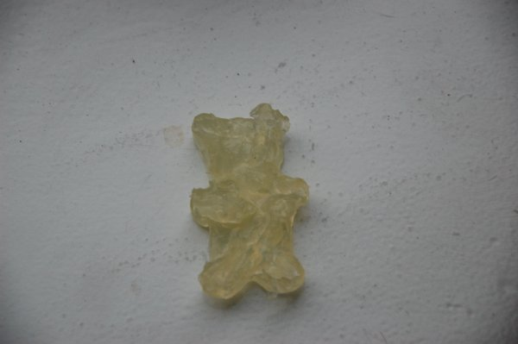
Using your own bioplastic recipe
Kombucha
Gummi bears :)
Notes:
http://www.gauirenata.com/2017/03/23/soft-robots-biomaterials-research-final/
bioplastics out of http://www.digitalspy.com/tech/news/a800605/meet-the-weird-robot-stingray-made-from-rat-hearts/
https://www.shapeways.com/blog/archives/374-cooking-molding-bioplastics-at-home-recipes-results-tips.html

Slide 31
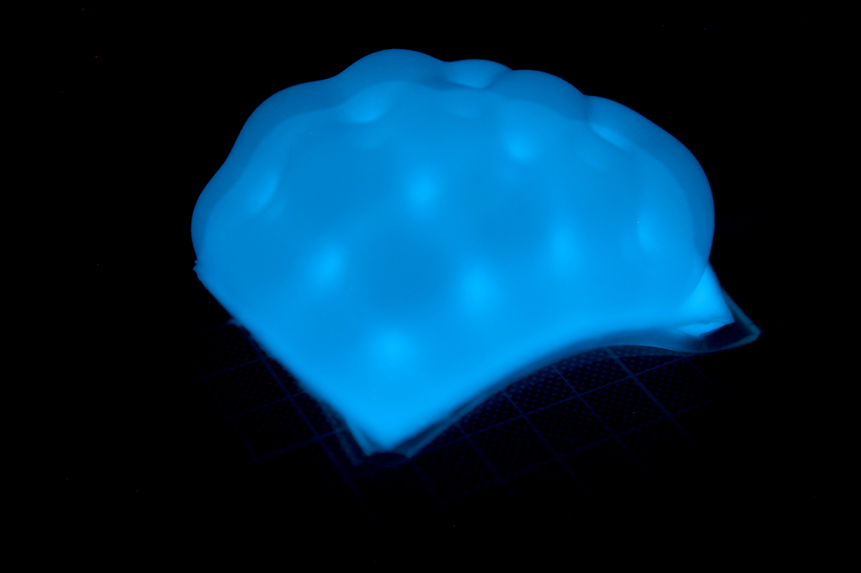
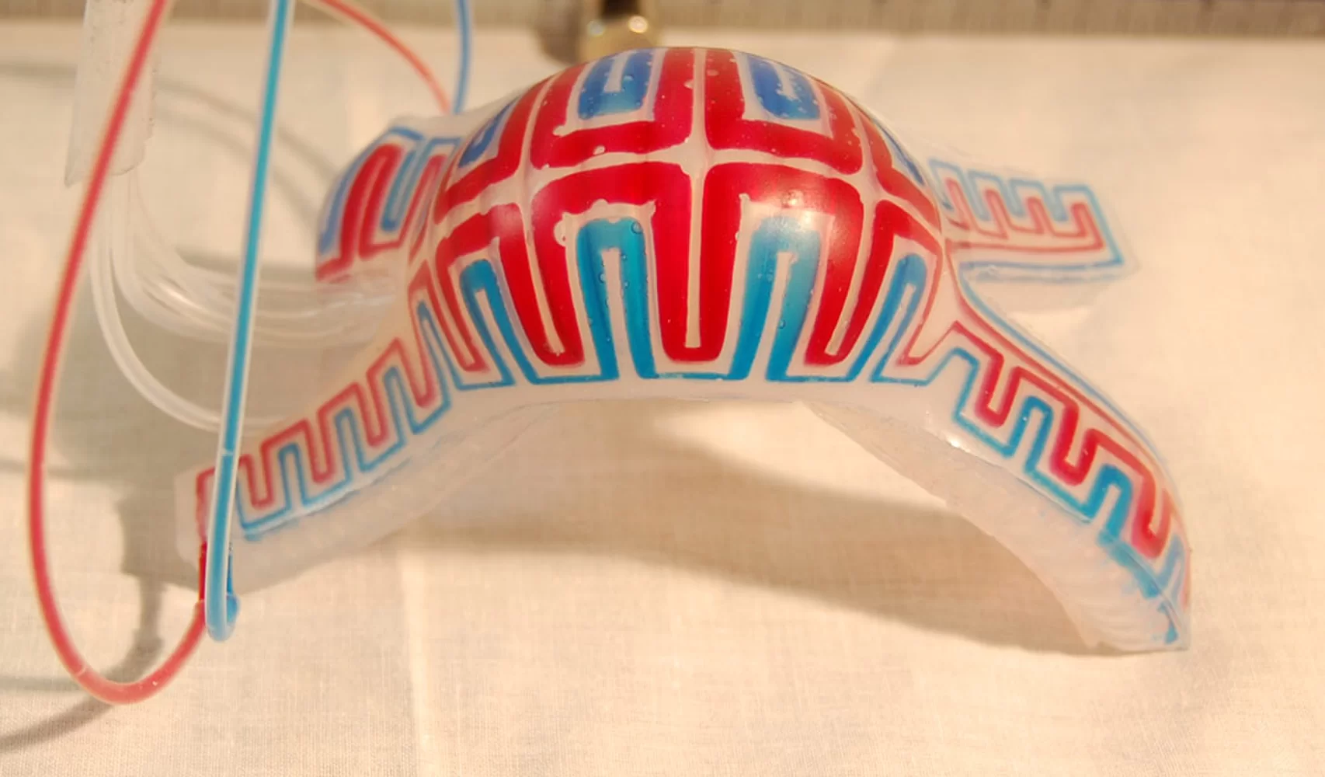
Adding Colour
Electroluminescence Pigments
Glow in the dark threads
Pigments for food (natural Dyeing)
Notes:
Electroluminescence Pigments: https://www.glonation.com/index.php

Slide 32
Soft materials other techniques
melting cutting and engraving laser cutter
Using printer for Multi Materials
SLA Printer Formlabs

Slide 33
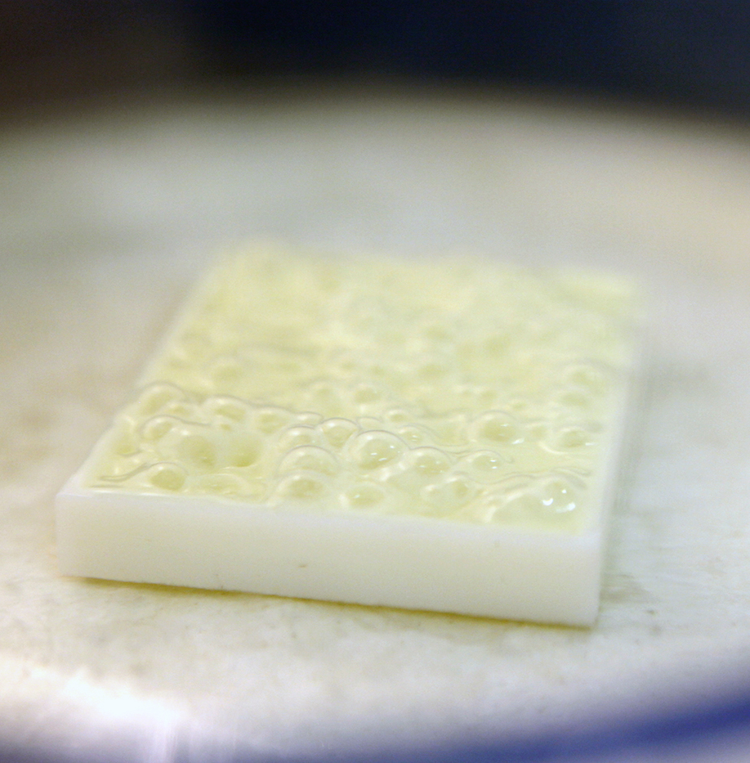
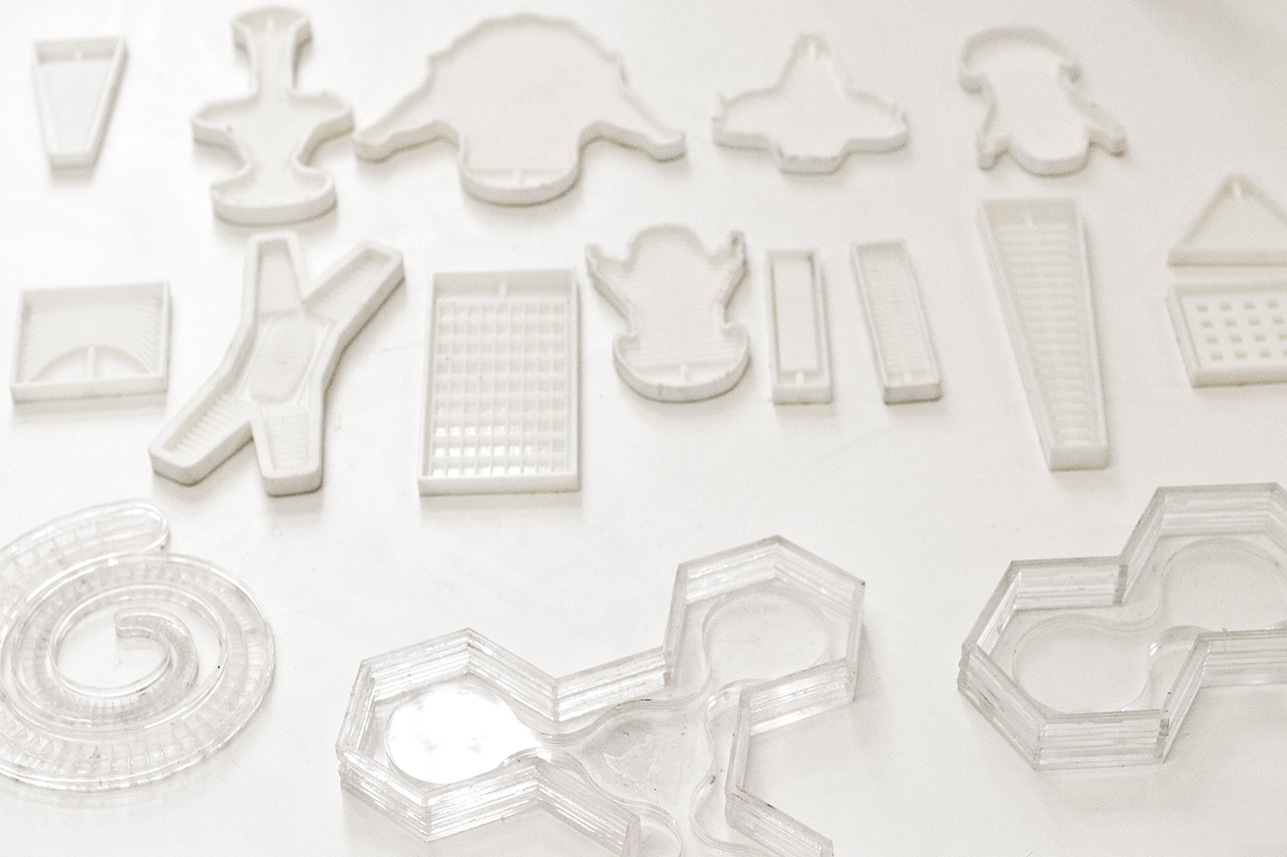
Designing your own moulds
Notes:
http://materiability.com/portfolio/soft-robots-diy/#&gid=3&pid=2

Slide 34
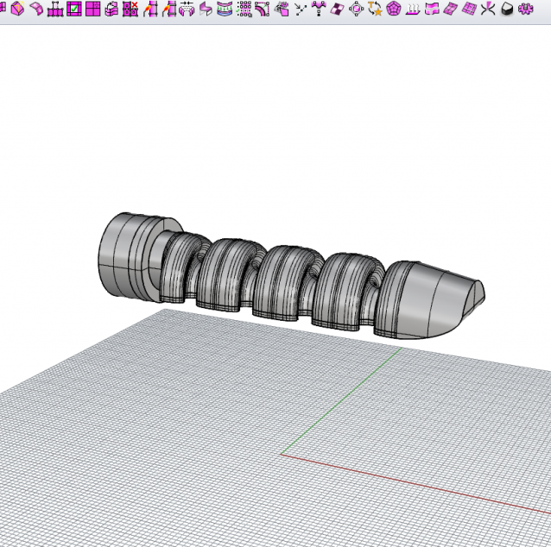
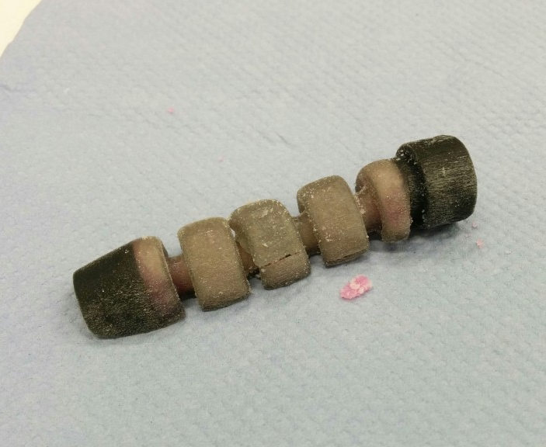
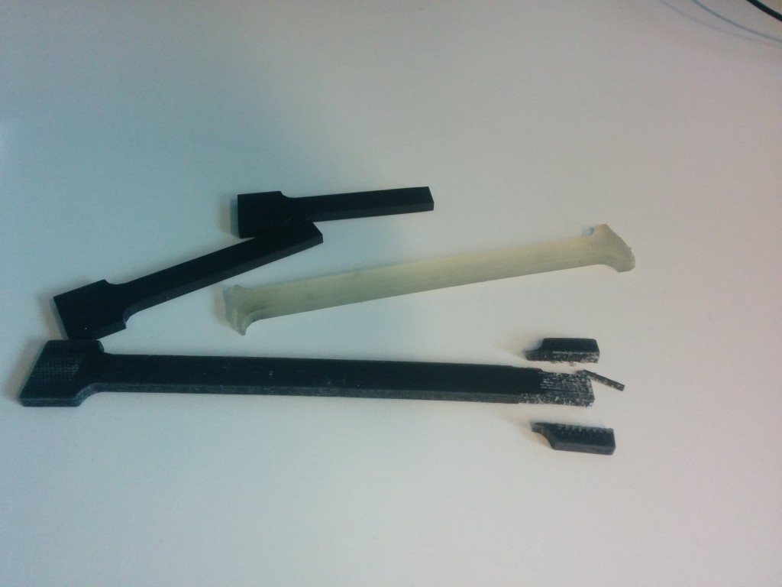
Designing for 3D printing
Notes:
https://softrobotics2015.weblog.tudelft.nl/

Slide 35
References
https://softroboticstoolkit.com/tunable-actuators
https://softroboticstoolkit.com/book/miniature-soft-bending-actuator-embedded-coiled-muscles
Soft robotics: a bioinspired evolution in robotics: http://www.cell.com/trends/biotechnology/fulltext/S0167-7799(13)00063-2
Design control and fabrication soft robotics: https://www.nature.com/articles/nature14543
Modelling Soft robotics:https://www.youtube.com/watch?time_continue=103&v=qHNCTC4qv-c
https://rrl.epfl.ch/page-86159-en.html
Modeling, Simulation and Control of Soft Robots with SOFA https://softroboticstoolkit.com/sofa
Soft elecronics: http://www.innovationtoronto.com/2016/02/soft-electronic-robotic-fingers-take-robotics-to-a-whole-new-level/
Video: https://www.youtube.com/watch?v=O7dA9df512w&feature=youtu.be
Notes:
https://www.youtube.com/watch?time_continue=103&v=qHNCTC4qv-c

Slide 36
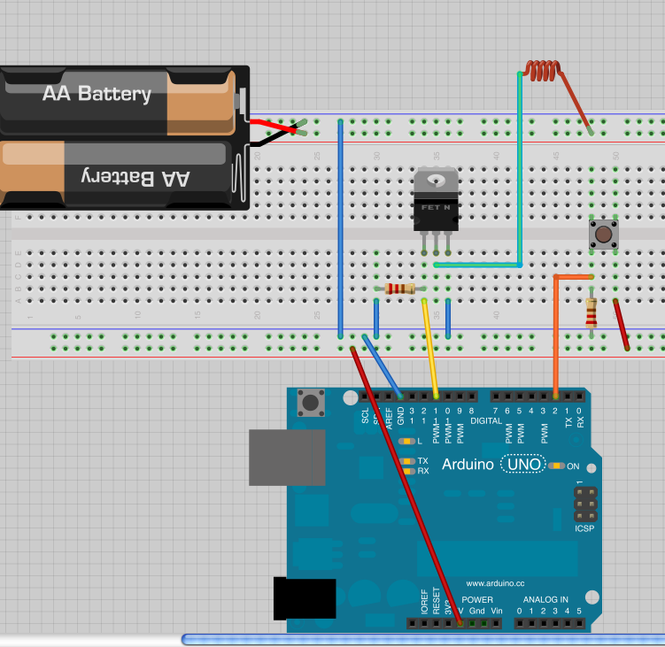
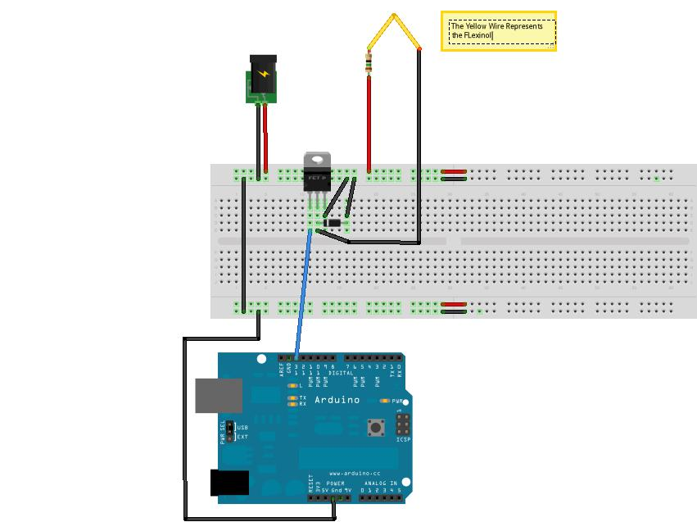
Controlling SMA with Arduino
http://elab-kh-berlin.de/courses/seamless_transitions/?p=913
Notes:
//e_lab Kunsthochschule Berlin Weißensee http://elab-kh-berlin.de/courses/seamless_transitions/?p=913
CODE
*/
int sensorValue=0;
int SMA=9;
// the setup routine runs once when you press reset:
void setup() {
// initialize serial communication at 9600 bits per second:
Serial.begin(9600);
pinMode(SMA,OUTPUT);
}
// the loop routine runs over and over again forever:
void loop() {
// read the input on analog pin 0:
sensorValue = analogRead(A0);
// if the sensorValue is smaller than 550 (threashold)
if (sensorValu5 > 550){
//Turn on the SMA pin
digitalWrite(SMA,HIGH);
// and wait for 1 sec
delay(1000);
// turn off the SMA pin
digitalWrite(SMA,LOW);
}
else{ //otherwise
// do nothing
}
// print out the value you read:
Serial.println(sensorValue);
delay(10); // delay in between reads for stability
}

